Slide 1
Nursing Homes Ireland:
Concern over Closures Report
August 2024
C24-139

Slide 2
Research Methodology
Quantitative Research
August 2024
Online Omnibus Survey
National Representative sample of 1,000 people
A nationally representative survey was carried out amongst a sample of 1,000 people.
Quotas were placed on the number of interviews achieved in each demographic grouping (age, gender, region and social class) to ensure it matched the Irish population.
All fieldwork was conducted between the 15th – 22nd August 2024.

Slide 3
Profile of Sample
Base: All Adults aged 18+ - 1,000
Profile of Sample
Q. A/B/C/D
Quotas were placed on age, gender, social class and region to ensure the sample was representative of the Irish population.

Slide 4
Presence of Children
Base: All Adults aged 18+ - 1,000
Presence of Children
Q. E/F
Presence of Children
Age of Children
Circa 5 in 9 have children, with over 1 in 2 having children aged 18 or over.

Slide 5
Knowing the Generations…
Gen Z
(18-26)
Millennials
(27-42)
30%
14%
Gen X
(43-58)
Baby Boomers
(59+)
28%
28%

Slide 6
Section 1
Concern over Nursing Home Closures

Slide 7
Concern over Potential Lack of Nursing Home Care in Local Community
Q.1 If you or a family member required Nursing Home Care, how concerned or not would you be if the care was not available in your local community?
Base: All adults 18+ - 1,000
Concern over potential lack of local Nursing Home Care
%
Extremely concerned (5)
97%
Very concerned 57%
say they would be concerned if they or a family member could not access Nursing Home Care in their local community
Very concerned (4)
Concerned97%
Moderately concerned (3)
Slightly concerned (2)
Not at all concerned (1)
Not concerned 3%
Q. 1
Mean Score:
3.6
Almost all claimed they would be concerned if they or a family member could not access Nursing Home Care in their local community, with almost 6 in 10 claiming to be very or extremely concerned.

Slide 8
Concern over Potential Lack of Nursing Home Care in Local Community
Base: All adults 18+ - 1,000
Q.1 If you or a family member required Nursing Home Care, how concerned or not would you be if the care was not available in your local community?
n=277
n=510
n=276
n=490
n=305
n=142
Q. 1
Baby Boomers, Females and Gen X were more likely to be very / extremely concerned that they or a family member would not be able to receive Nursing Home Care in their local community, if required.

Slide 9
Concern over Potential Lack of Nursing Home Care in Local Community x Region
Base: All adults 18+ - 1,000
Q.1 If you or a family member required Nursing Home Care, how concerned or not would you be if the care was not available in your local community?
n=269
n=291
n=265
n=175
Q. 1
Concern is greatest in Munster and lowest in Connaught/Ulster that Nursing Home Care might not be locally available, when needed.

Slide 10
Section 2
Attitudes towards Nursing Home Care in Ireland

Slide 11
Attitudes towards Nursing Home Care in Ireland
*Q.2 How much do you agree or disagree with the following statements?
Base: All Adults aged 18+ - 1,000
Neither /nor (3) | Mean Score
18% | 4.0
29% | 2.9
30% | 2.7
Strongly disagree
(1)
Strongly agree
(5)
Nursing Home Care should receive additional Fair Deal funding to be able to provide staff similar pay and conditions to those received by their counterparts providing the same care in public nursing homes
The Government is effectively preparing / planning for the care requirements of our ageing population
Nursing home care in Ireland is adequately funded by the Government
(%1/2)
(2)
(4)
(%4/5)
(5)
(77)
(38)
(33)
(47)
(23)
*Question introduced with explanation of Fair Deal Scheme
*Q.2
Nearly 4 in 5 agreed that Nursing Home Care should receive additional Fair Deal funding to be able to provide staff similar pay and conditions to their counterparts in public nursing homes. 2 in 5 do not believe that the government is effectively preparing for the care requirements of our aging population. Almost 1 in 2 believe that the government is properly funding Nursing Home Care in Ireland.

Slide 12
Nursing Home Care in Ireland should receive additional fair deal funding… x Gender & Generation
“Nursing Home Care should receive additional Fair Deal funding to be able to provide staff similar pay and conditions to those received by their counterparts providing the same care in public nursing homes.”
Base: All adults 18+ - 1,000
n=277
n=510
n=276
n=305
n=490
n=142
Q. 2
Strong consensus across demographics that Nursing Home Care should receive additional Fair Deal funding to be able to provide staff similar pay and conditions to their counterparts in public nursing homes - Gen Z slightly under index.

Slide 13
The Government is effectively preparing / planning for the care… x Gender & Generation
“The Government is effectively preparing / planning for the care requirements of our ageing population.”
Base: All adults 18+ - 1,000
n=277
n=276
n=510
n=490
n=305
n=142
Q. 2
High levels of disagreement that the Government is effectively preparing / planning for our aging population, particularly amongst Baby Boomers, Gen X and Females. Males and Millennials are most likely to cast split votes and Gen Z are more likely to show faith in the government’s preparations.

Slide 14
Nursing Home Care in Ireland is adequately funded by the government x Gender & Generation
“Nursing Home Care in Ireland is adequately funded by the government.”
Base: All adults 18+ - 1,000
n=277
n=276
n=510
n=490
n=305
n=142
Q. 2
Higher consensus that Nursing Home Care in Ireland is not adequately funded by the government - Gen Z are the only outlier most likely indicating a lack of awareness on the subject.

Slide 15
Nursing Home Care in Ireland is adequately funded by the government x Region
“Nursing Home Care in Ireland is adequately funded by the government.”
Base: All adults 18+ - 1,000
n=269
n=291
n=265
n=175
Q. 2
Those living in Dublin were more likely to believe that the government is properly funding nursing home care in Ireland versus those living in Connaught/Ulster or Munster. Although no significant difference in disagreement levels – this means higher proportion in the neither/nor camp in those regions

Slide 16
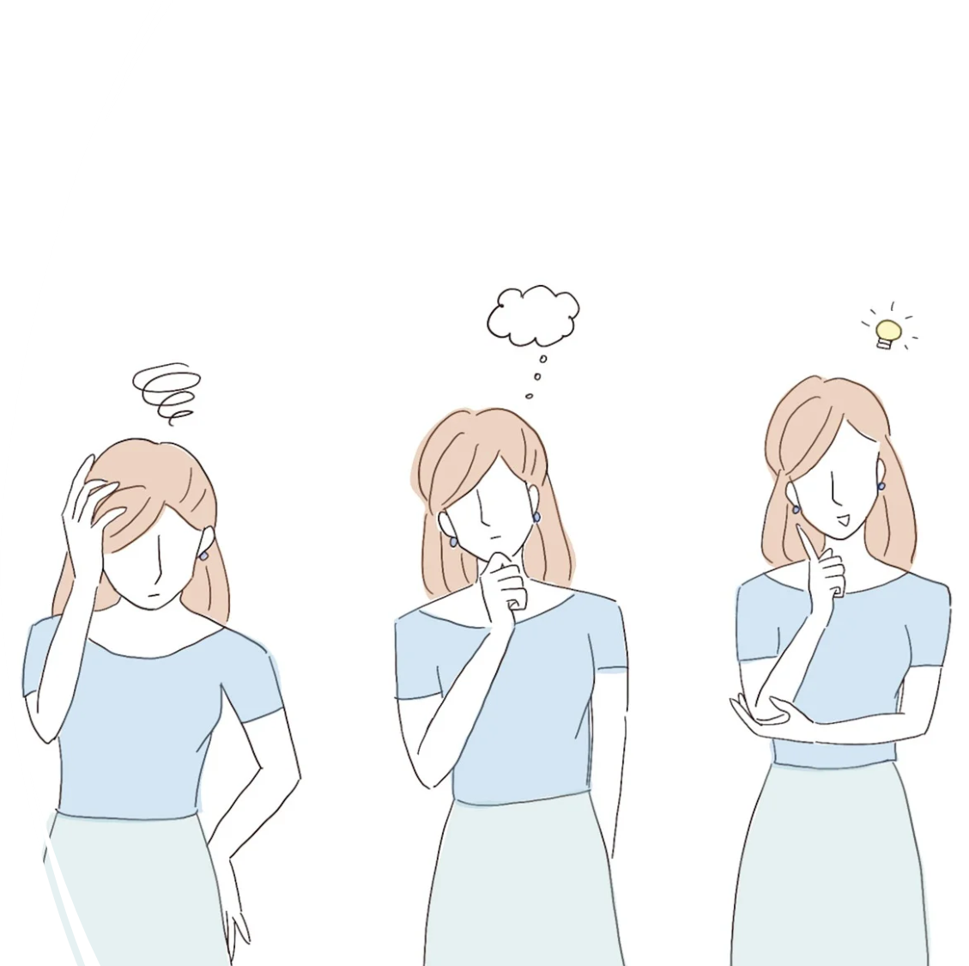
Key Insights

Slide 17
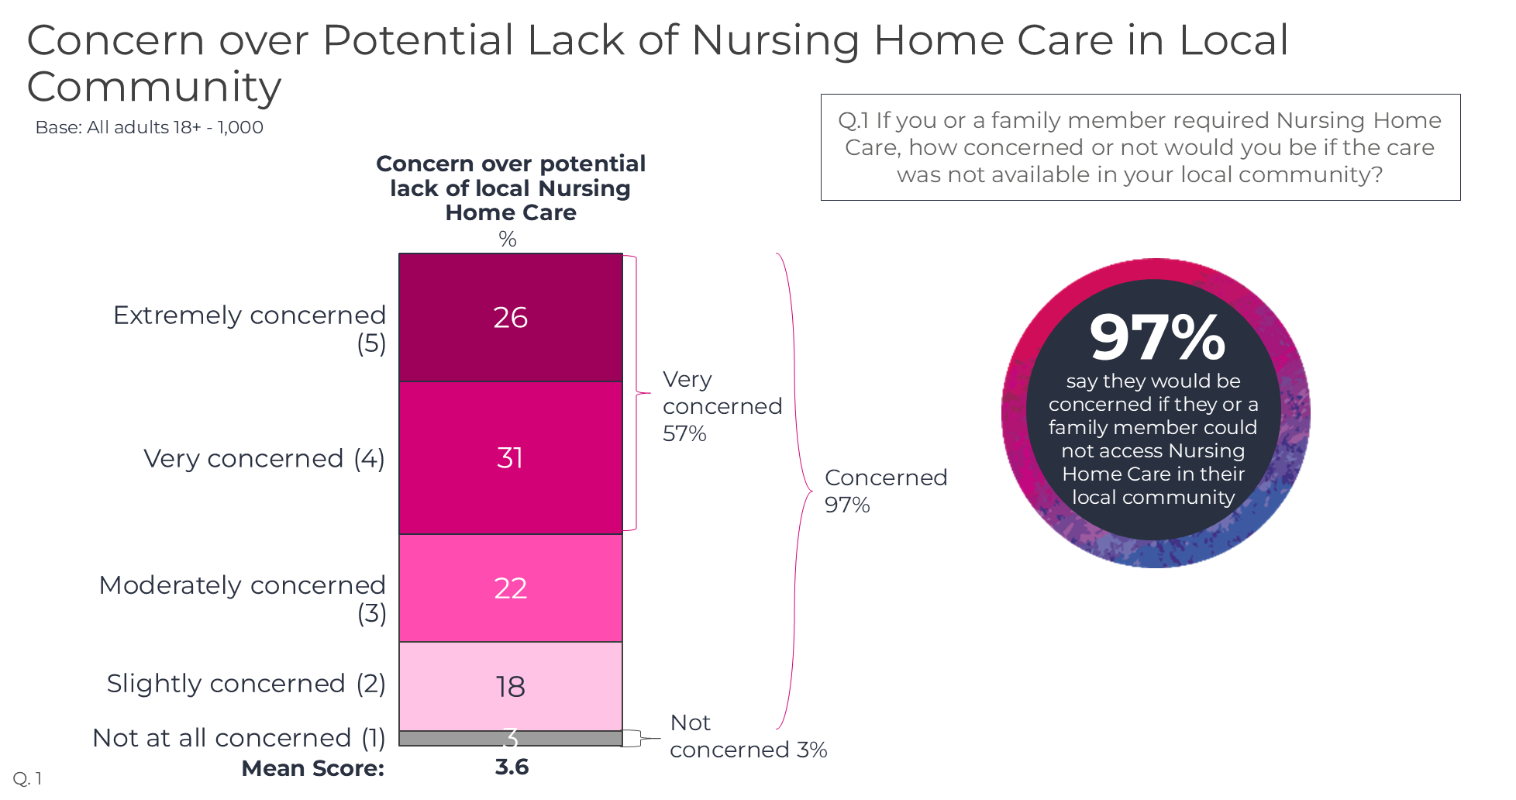
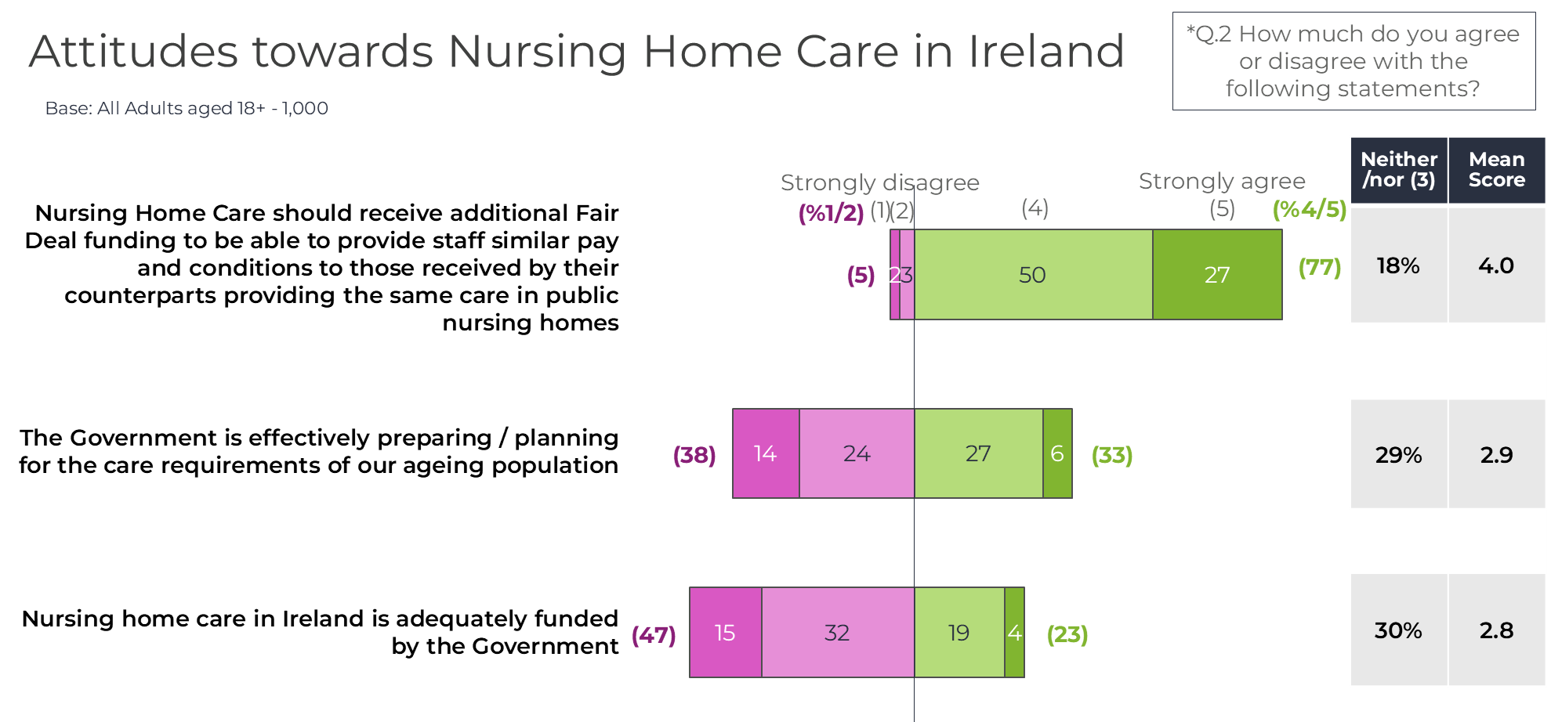
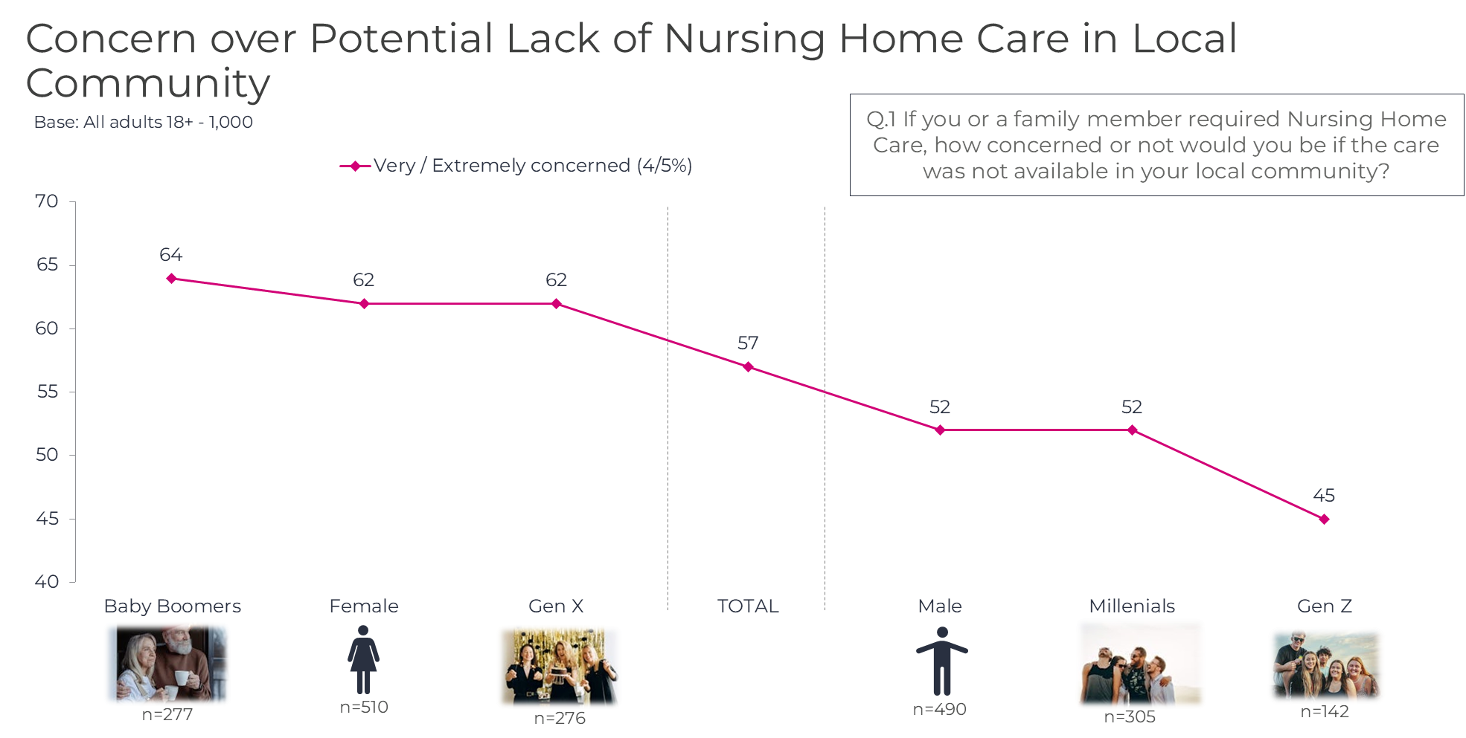
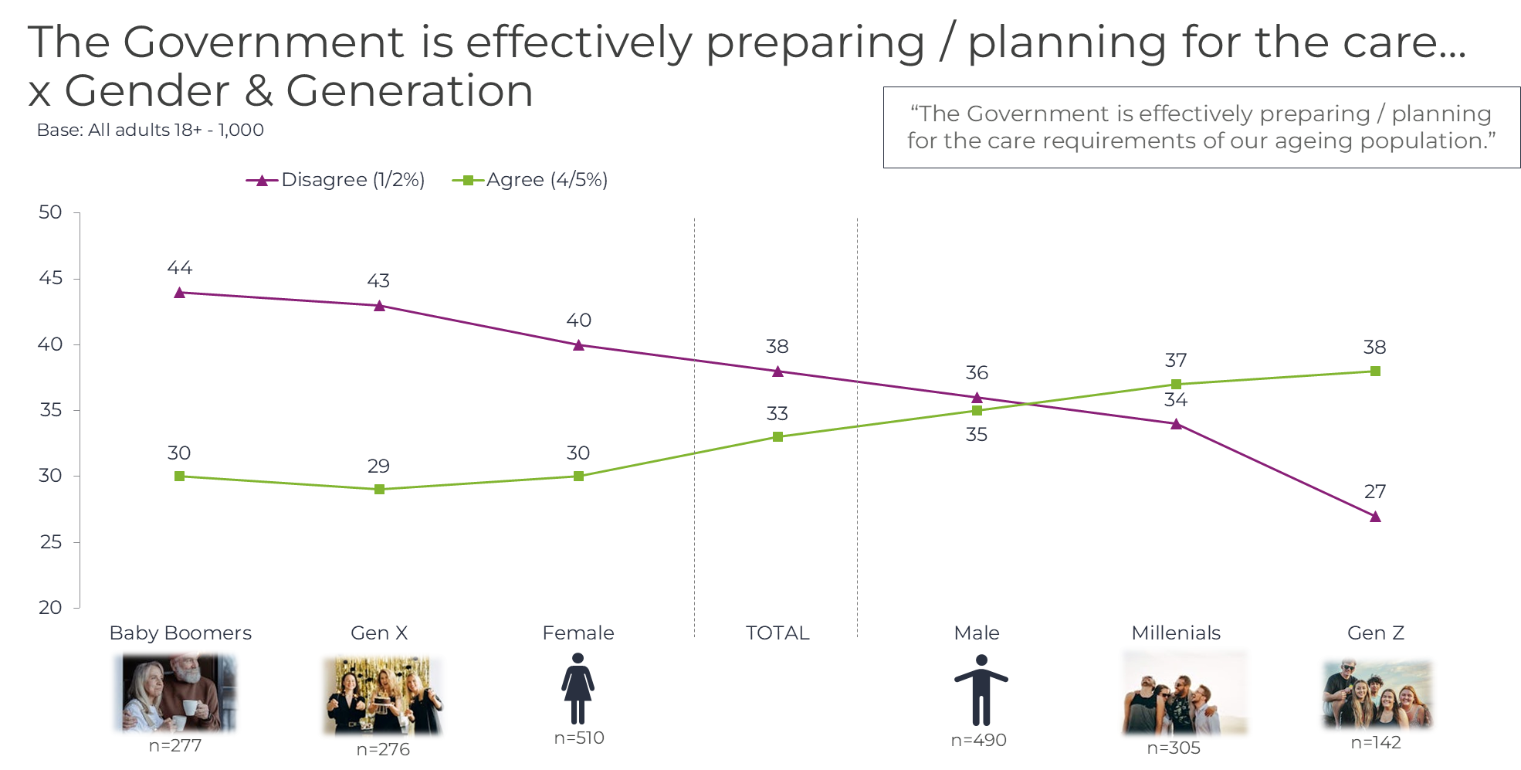
Key Insights
97% are concerned over Nursing Home closures, with 57% being very / extremely concerned.
Almost all claimed they would be concerned if they or a family member could not access Nursing Home Care in their local community, with almost 6 in 10 claiming to be very or extremely concerned.
Nearly 4 in 5 believe that Nursing Homes should receive additional fair deal funding.
Nearly 4 in 5 agreed that Nursing Home Care should receive additional Fair Deal funding to be able to provide staff similar pay and conditions to their counterparts in public nursing homes.
This opinion is echoed across the demographics with only Gen Z slightly under index.
Awareness of issues should be driven amongst Males, Millennials and Gen Z.
These groups have identified themselves as showing a lack of awareness / concern on the issues facing Nursing Homes in Ireland today.
NHI could benefit by highlighting these target groups to drive awareness in future.

Slide 18
Coyne Research 16 The Courtyard Kilcarbery Business Park Dublin D22F6K2 Ireland.
info@coyneresearch.com +353 (0)1-461 1040

